Slide 1
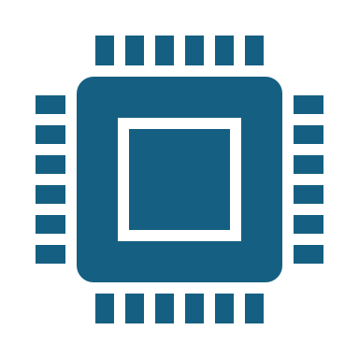
Sign Language Interpreter Running on Raspberry Pi
Group ViitTomakieli
Kandel Sushila, Lipponen Seppo, Viitala Jussi & Varpula Teemu

Slide 2
Introduction
Our project aims to develop a system that can detect Finnish sign language alphabets.
Using OpenCV and MediaPipe .
Running on Raspberry Pi.
Using our own image collection to train the recognition model.
Excluding characters from Z-Ö that would require motion.
Few control signs are added to trigger events like write character, space, backspace and clear buffer.

Slide 3
Project Overview
Recognition is made from live video feed from the Raspberry Pi Camera Module. If sign is recognized, it will be show in text screen for the receiver and signer.
Hardware Requirements:
⦁ Raspberry Pi
⦁ Raspberry Pi Camera Module
⦁ 1602 LCD display (Optionally can use second one for the signer)
Software Requirements:
⦁ Python
⦁ OpenCV
⦁ MediaPipe
Notes:
Sushila

Slide 4
Project Version and Deadline
Project Version | Deadline for System Completion | Relevant Dates | Scope and Deliverables
1.0 | 1.3.2024 | 26.2.2024 | Raspberry Pi setup
1.1 | 6.3.2024 | 29.2.2024 | Raspberry Pi image recognition
1.2 | 8.3.2024 | 8.3.2024 | Raspberry Pi working display
1.3 | 8.3.2024 | 8.3.2024 | Three- character identification
1.4 | 15.3.2024 | 15.3.2024 | Whole alphabet identification and control commands
1.5 | 27.3.2024 | 27.3.2024 | Document including implementation
1.6 | 4.4.2024 | 4.4.2024 | Casing the hardware in card box
2.0 | 4.4.2024 | 4.4.2024 | Sign Detector final version

Slide 5
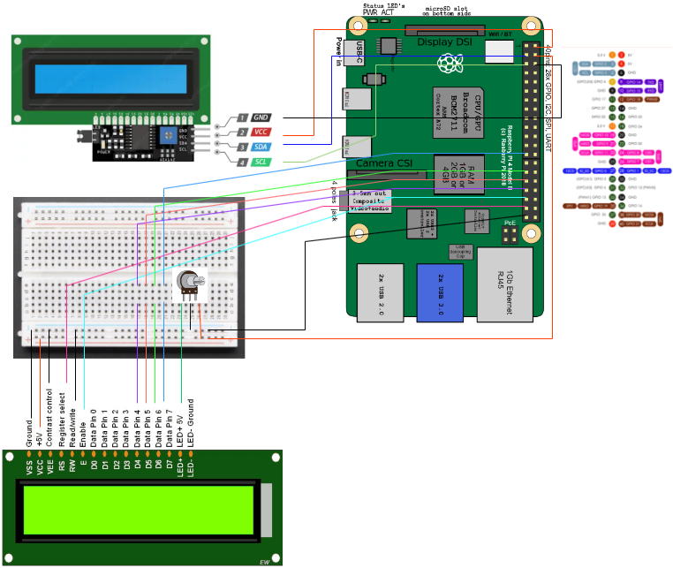
Notes:
Kytkentäkaavio, ja on kaksi näyttö. I2C upper on , and lower one is . Raspberry Pi 4B.
Toinen näyttö I2c piirillä ja toinen ilman

Slide 6
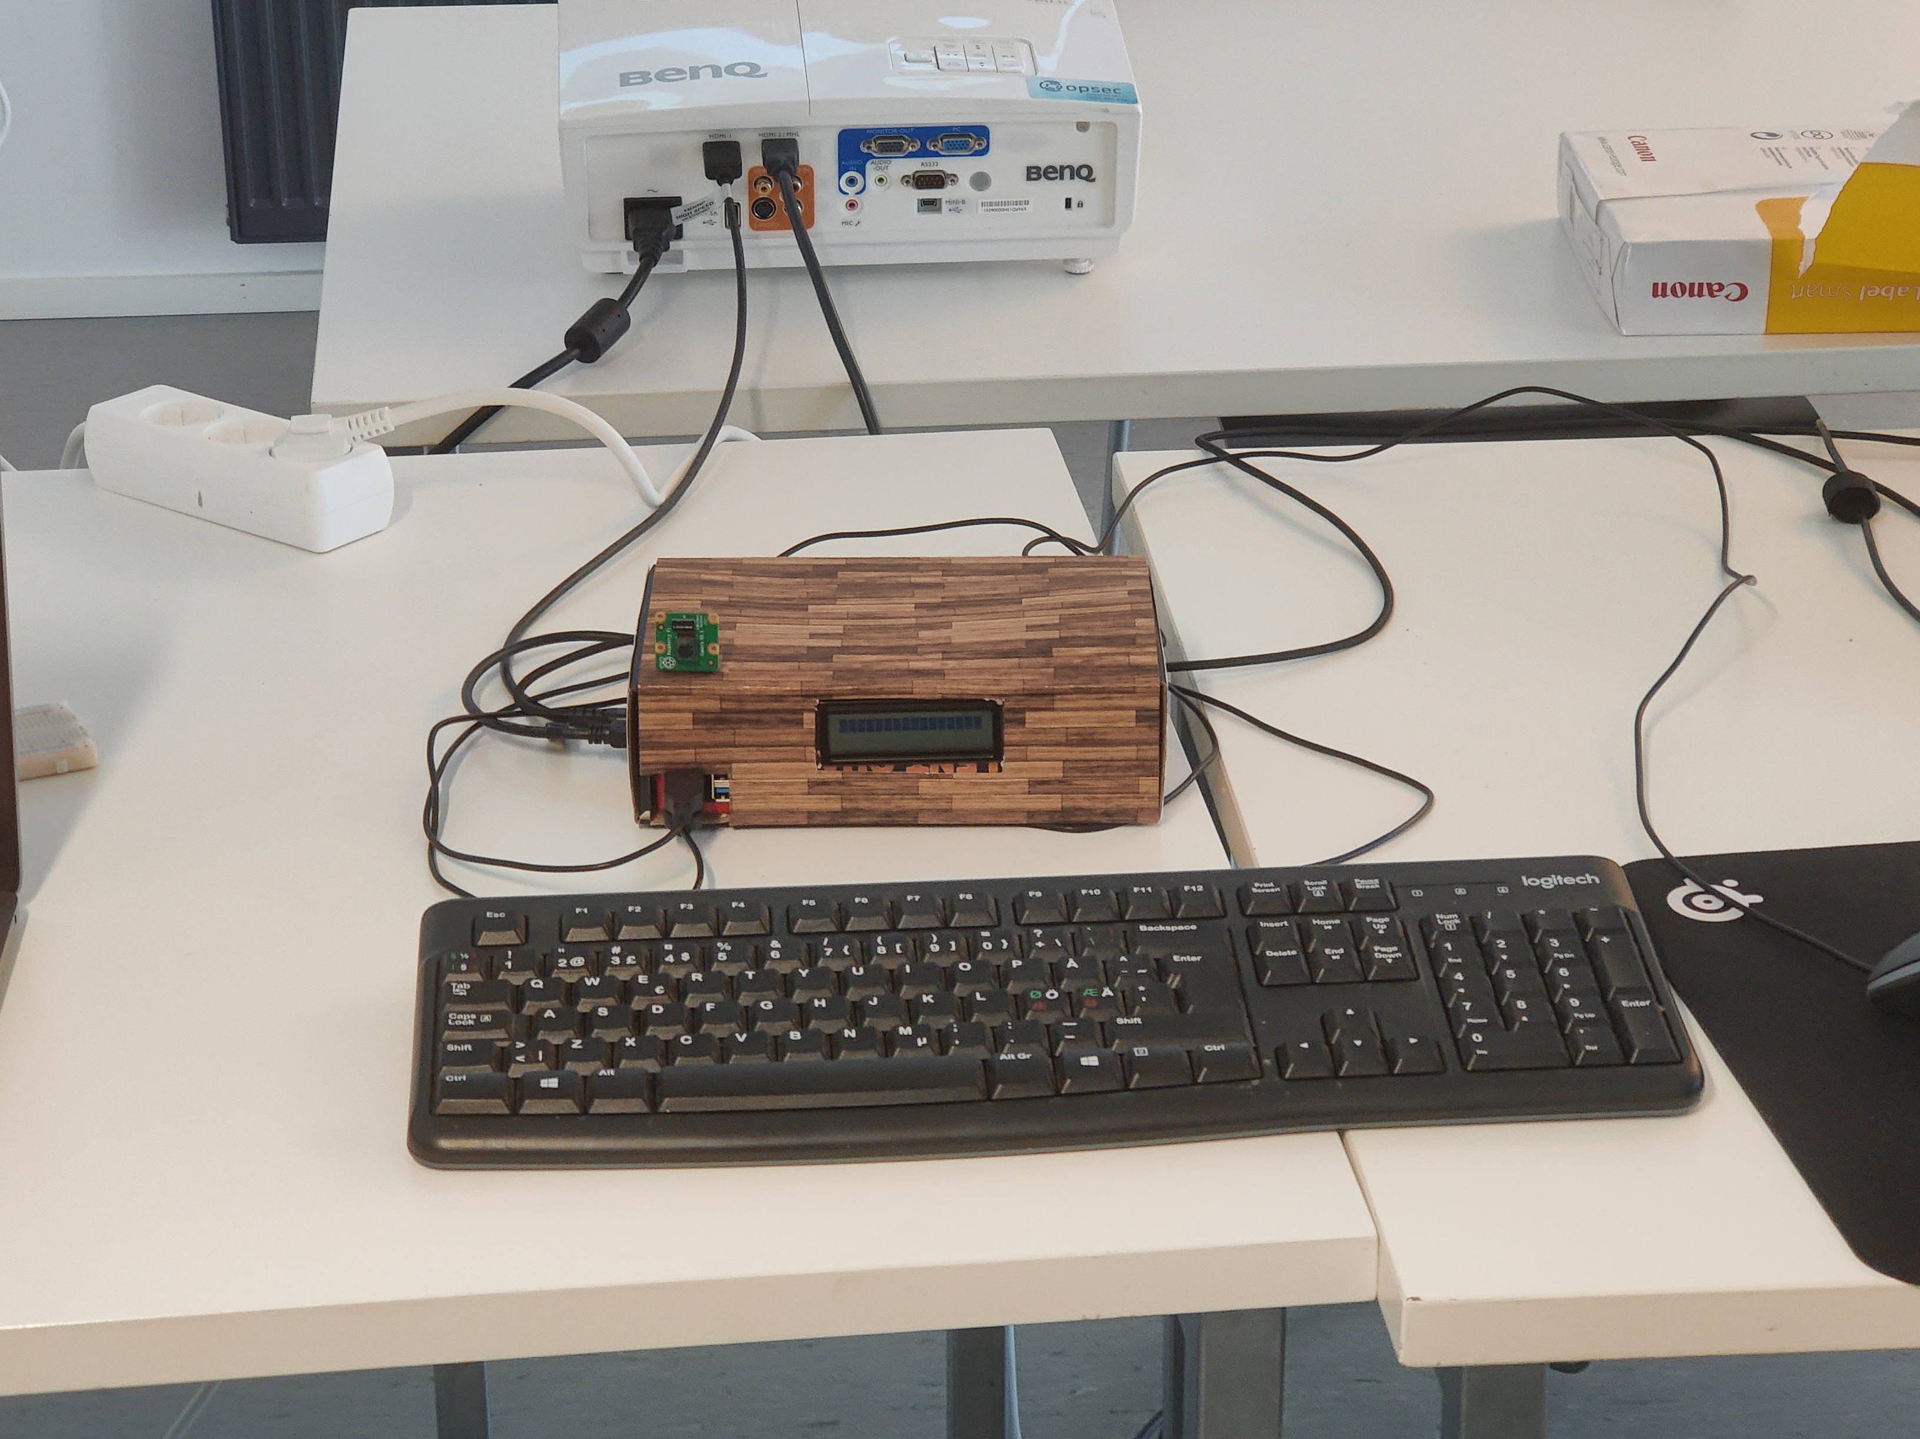
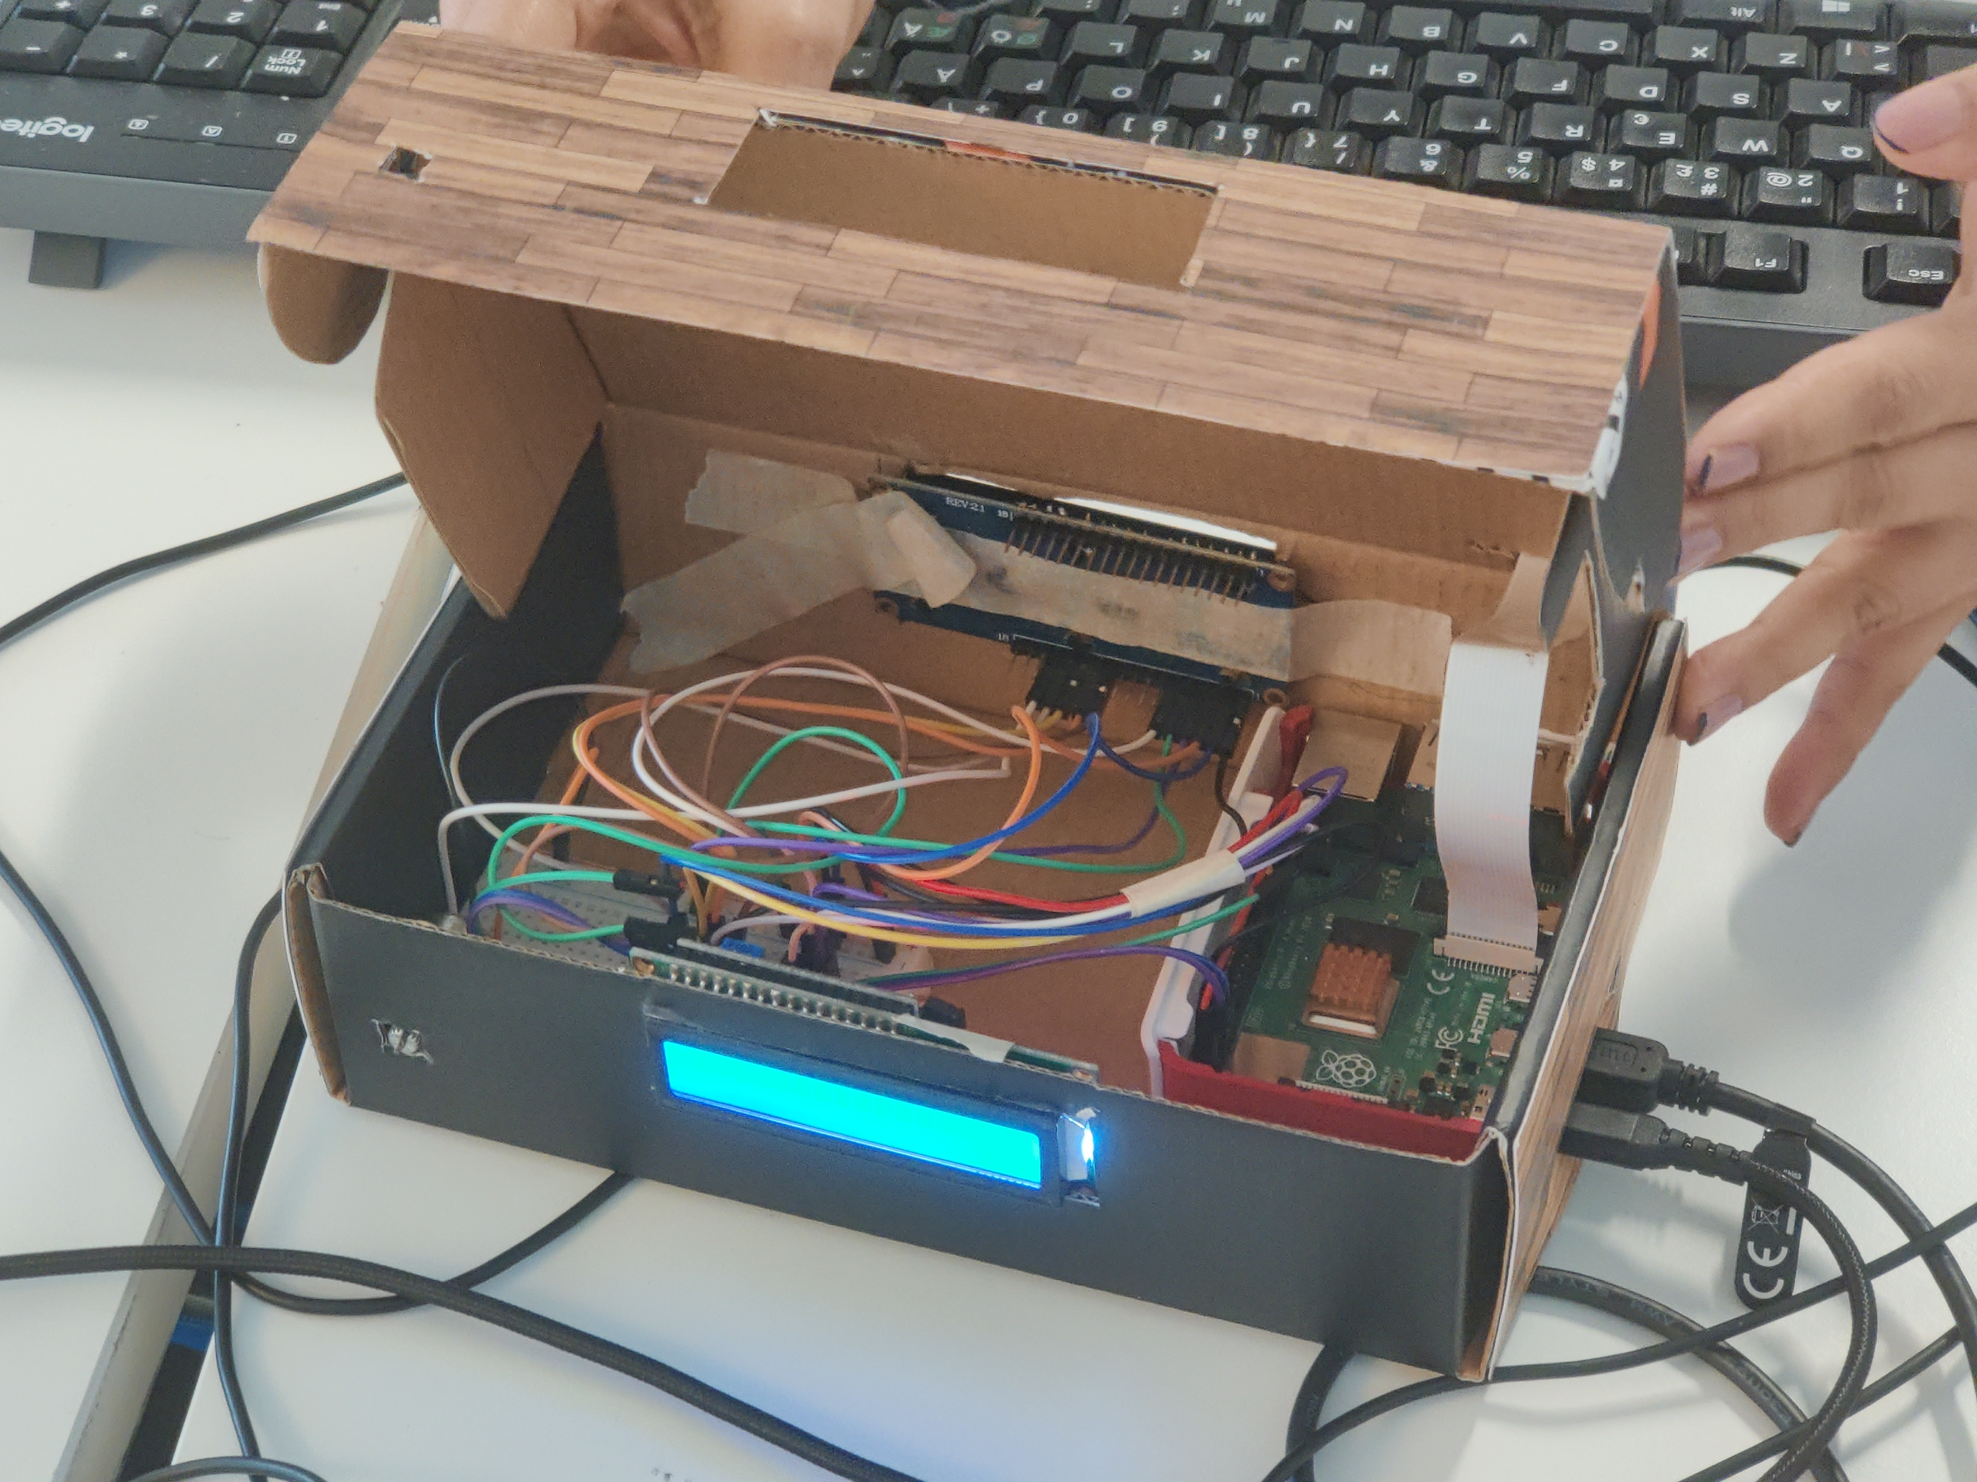
Images
Notes:
kytkentälevy

Slide 7
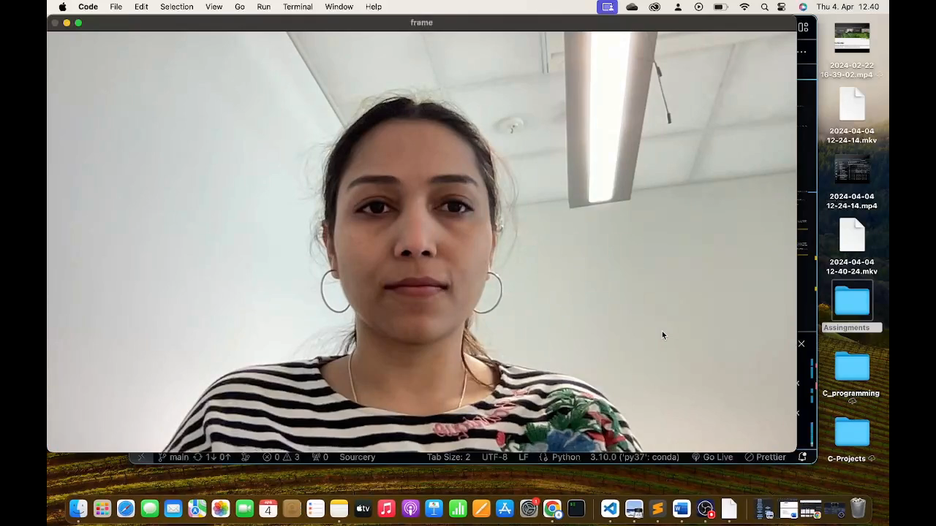
Notes:
Pätkä ohjelman toiminnasta

Slide 8
Functional Implementation
Creating model
Collecting images
Capturing sign images. We used 100 images per sign
Create dataset
Getting hand landmarks from images and saving them for training
Training model
Creating recognition model from dataset using random forest classifier

Slide 9
Functional Implementation
Comparing sign gestures
Image Capturing
Capturing image with pi camera
Getting hand landmarks
Finding hand from image
Getting hand landmarks and saving datapoints
Depending on hand of the regognized sign
Left is used for commnads
Right for alphabet signs
Recognized alphabet can be added or removed from ledscreen

Slide 10
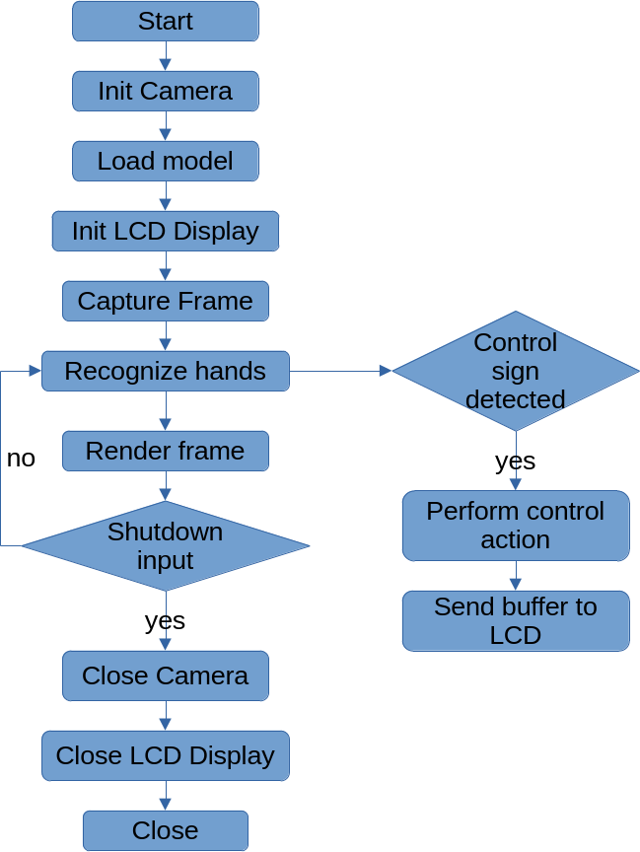
Sign Detector Flowchart

Slide 11
Limitations
Missing few characters
Signs that need movement recognition
J is made with still image because it differs enough with other signs.
Z,Å,Ä,Ö signs are not include due to the motion requirement.
Detection of these left out signs will be left for future versions
Hardware limitations
Raspberry still needs powercord to operate
Dataset training still requires external display

Slide 12
Challenges
Multiple operating systems
Windows, macOs, Linux
Required python versions
First we had different python versions while compiling code
Creating dataset with different devices
Different resolutions of cameras

Slide 13
Implementation Changes
Changes to original requirements
External buttons are replaced with hand commands
Leds are replaced wth LCD and keyboard
Carboard case replaced 3D printed casing

Slide 14
Possible Improvements
Refinement of UX
Movement interpreter addition
3D printed case
Replacing breadboard with custom PCB
2 way communication
Bigger screens with more information

